Slide 1

Establishing Bovine Pangenome Graphs
Animal Genomics
Institute of Agricultural Sciences
Danang Crysnanto
Doctoral defense
11 06 2021, ETH Zurich

Slide 2
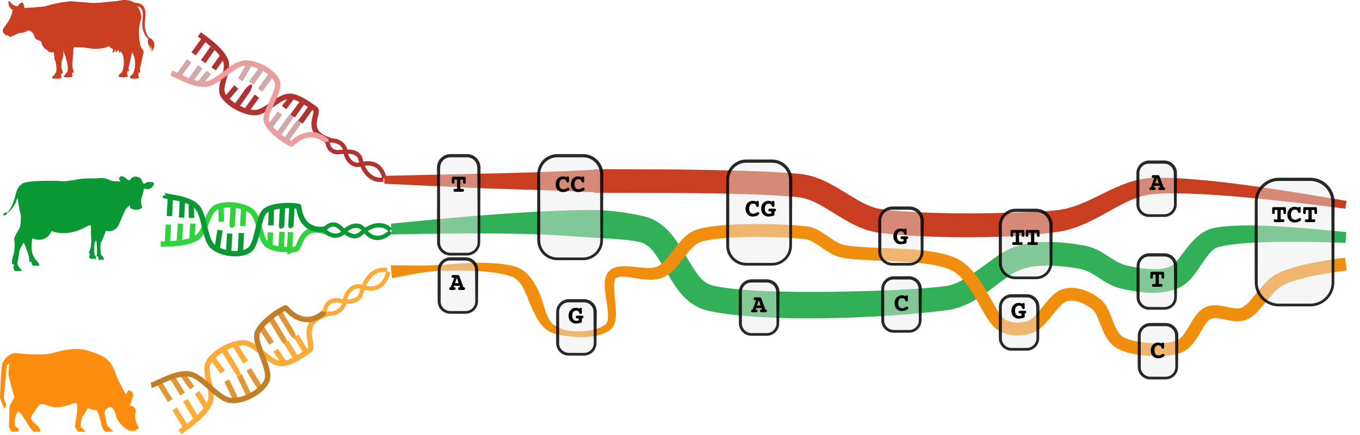
Agenda
Introduction
Research Objectives
Results and Discussion
Conclusions
Outlook
Notes:
I will start.. Continue .. Talk.., finish

Slide 3
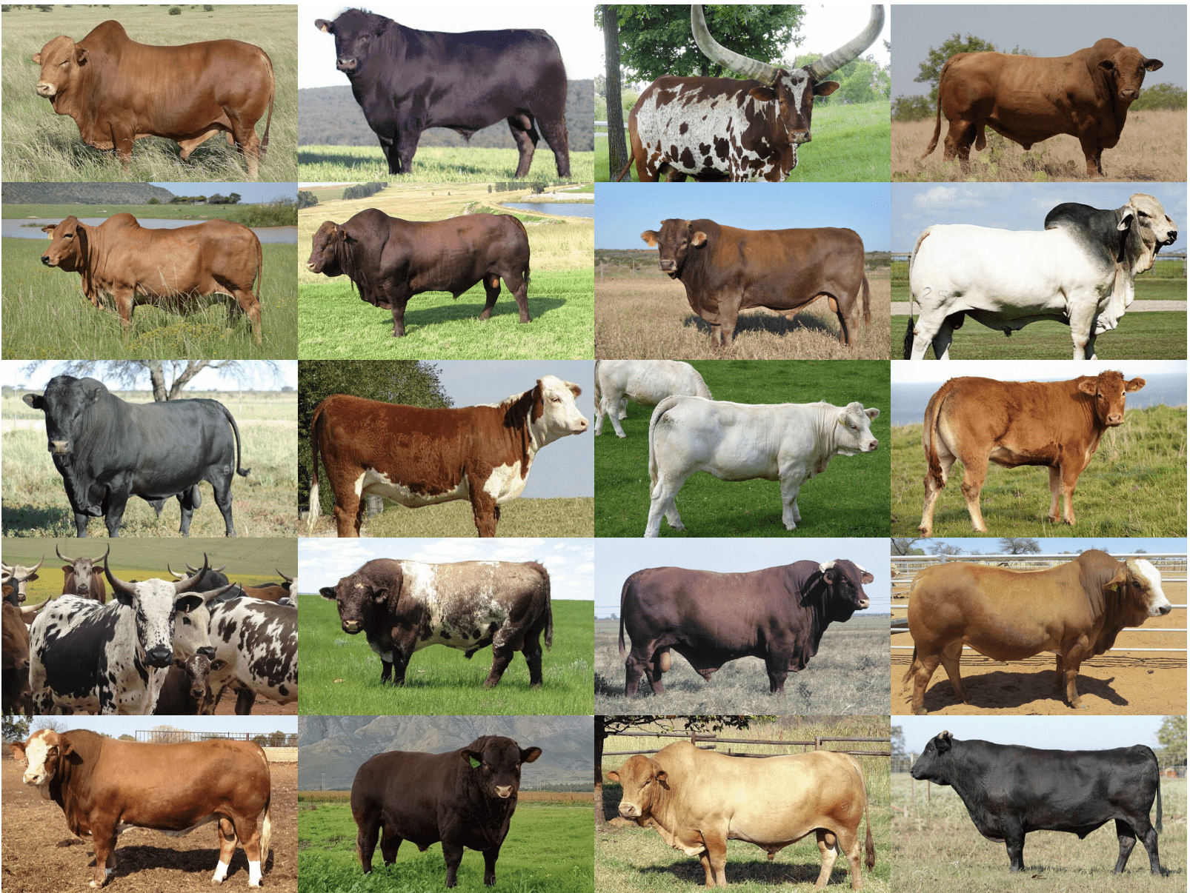
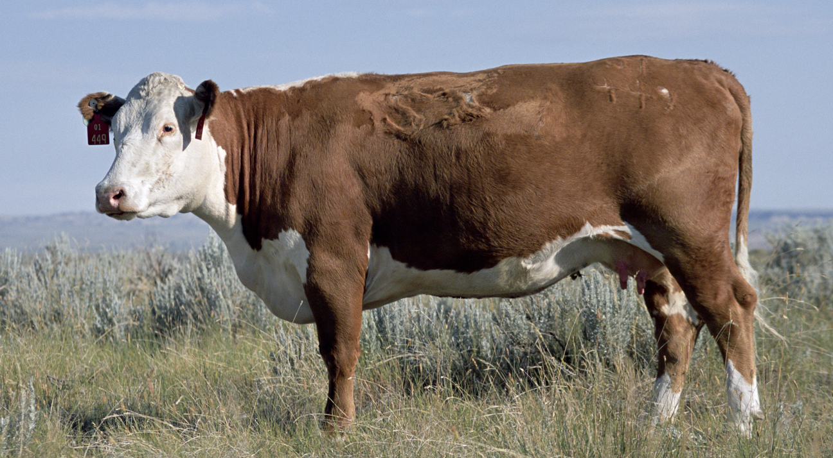
The bovine linear reference genome
Reference sequences are essential for many genomic analyses
Cattle reference genome was built from a single Hereford cow
Cattle exhibit high genetic diversity and diverged into hundreds of distinct breeds
Rosen et al., 2020
Bickhart et al., 2020
Introduction Part 1 Part 2 Part 3 Conclusions

Slide 4
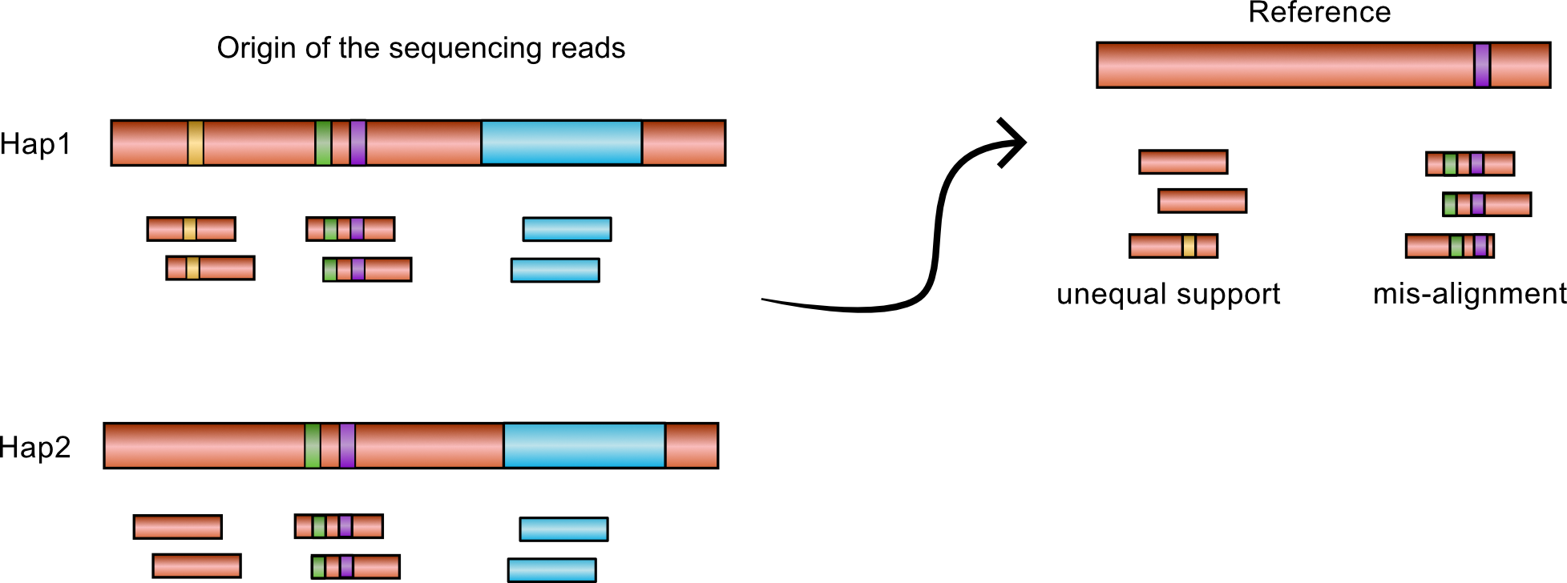
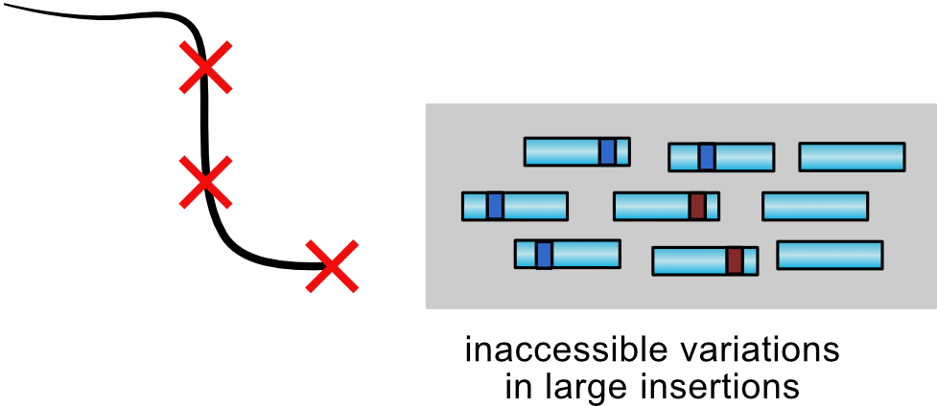
Linear genomes are unaware of genetic variations
Linear genomes do not sufficiently represent the complete species diversity
Prone to reference bias
Soft reference bias: suboptimal mapping of the sequencing reads diverged from reference
Hard reference bias: lack large structural changes diverged in the population
Pritt et al., 2018
Sherman and Salzberg, 2020
Introduction Part 1 Part 2 Part 3 Conclusions
Notes:
It has been reported in multiple species that reference genome lack million of bases that present in other animal in the population but not in the reference individual

Slide 5
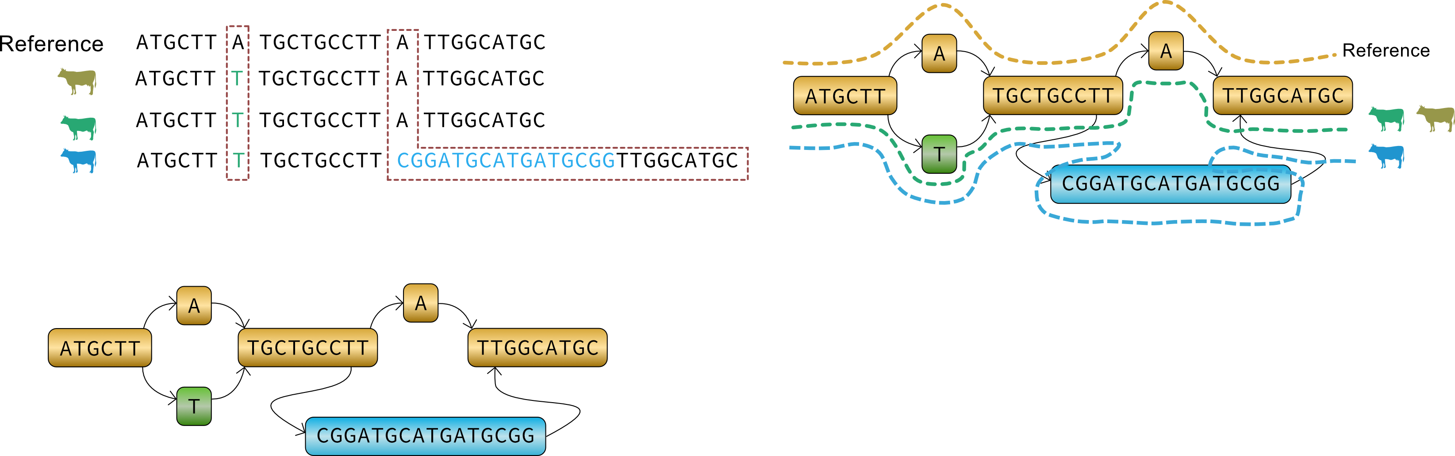
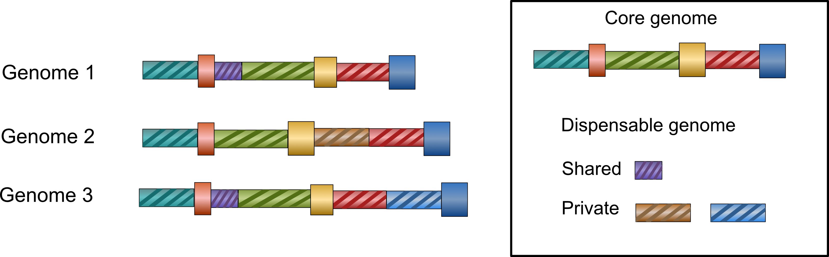
Towards a more representative reference genome
Genomic resources are generated at an unprecedented rate
The concept of pangenome
A genome graph represents allelic diversity in a compact and coherent reference structure
Hayes and Daetwyler, 2019
Golicz et al., 2020
Paten et al., 2017
Introduction Part 1 Part 2 Part 3 Conclusions

Slide 6
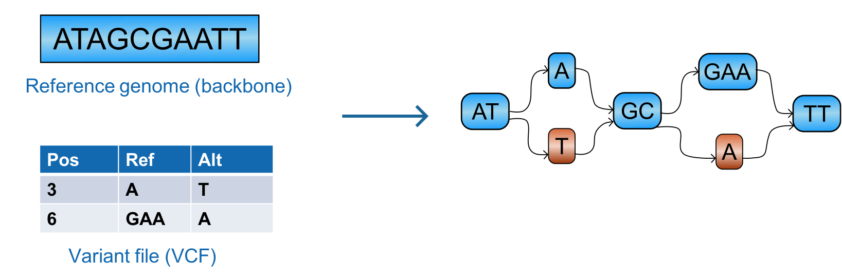
Genome graph implementations
Variation graphs: Extend a linear genome with small variations
Multi-assembly graphs: Integrate multiple genome assemblies
Garrison et al., 2018
Li et al., 2020
Introduction Part 1 Part 2 Part 3 Conclusions

Slide 7
Research Objectives
Utility of graph genomes for sequence variant analysis in the cattle populations
Part 1: Variant genotyping from local variation graphs
Part 2: Construction of breed-specific and multi-breed variation graphs
Part 3: Establishing a bovine multi-assembly pangenome graph
Introduction Part 1 Part 2 Part 3 Conclusions

Slide 8
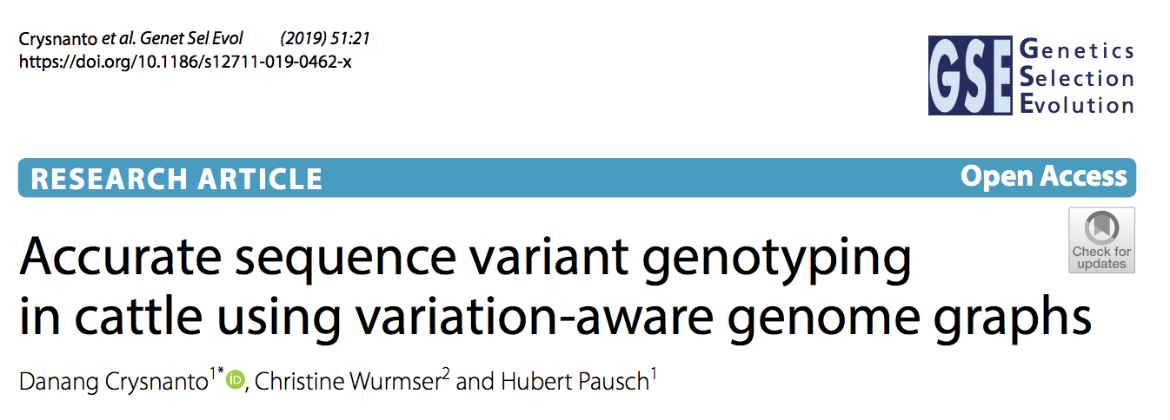
Part 1: Variant genotyping from region-specific graphs
Implemented a graph-based variant discovery pipeline based on the Graphtyper software
Genotyped 49 Original Braunvieh whole-genome samples
1st pass: Discovery
2nd pass: Refinement
1 Mb window
Eggertson et al., 2017
Eggertson et al., 2020
Introduction Part 1 Part 2 Part 3 Conclusions

Slide 9
Graph genome facilitates more accurate genotype calling
 | Genotype concordance | Non-reference sensitivity | Non-reference discrepancy | Opposing homozygous SNPs | Opposing homozygous Indels
GATK | 95.99 (96.02) | 93.81 (93.67) | 6.35 (6.29) | 0.73 (0.72) | 0.98 (0.99)
Graphtyper | 97.71 (97.75) | 98.26 (97.91) | 3.53 (3.46) | 0.36 (0.35) | 0.54 (0.54)
SAMtools | 97.68 (97.69) | 98.19 (97.53) | 3.60 (3.56) | 0.33 (0.32) | 0.67 (0.61)
*Values are reported from raw (filtered) genotypes in percentage (%)
Crysnanto et al., Genetics Selection Evolution 2019
Introduction Part 1 Part 2 Part 3 Conclusions

Slide 10
Graphtyper pipeline is competitive with linear based-tools
Compatible with genotype imputations
Computing requirements
Crysnanto et al., Genetics Selection Evolution 2019
Introduction Part 1 Part 2 Part 3 Conclusions

Slide 11

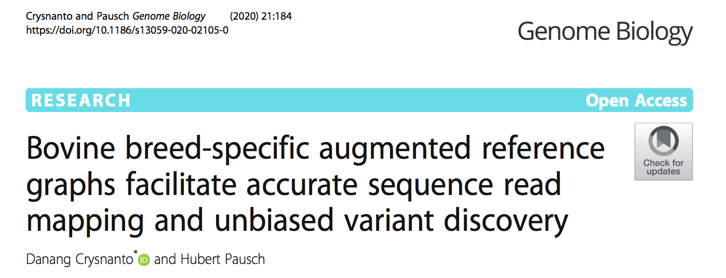
Part 2: Construction of breed-specific and multi-breed graphs
Augmented the ARS-UCD1.2 cattle reference with small variations from 4 European cattle breeds using the vg toolkit
Investigated read mapping, variant genotyping, and allelic balance
Introduction Part 1 Part 2 Part 3 Conclusions

Slide 12
Variant prioritization
Mapping breed-simulated reads to graphs with variations filtered based on allele frequency on the breeds
Mapping accuracy increases with the increasing number of variants added to the graphs
Mapping accuracy decreases when rare variants are added to the graph
Difference in mapping accuracy across breeds
Crysnanto and Pausch, Genome Biology, 2020
Introduction Part 1 Part 2 Part 3 Conclusions

Slide 13
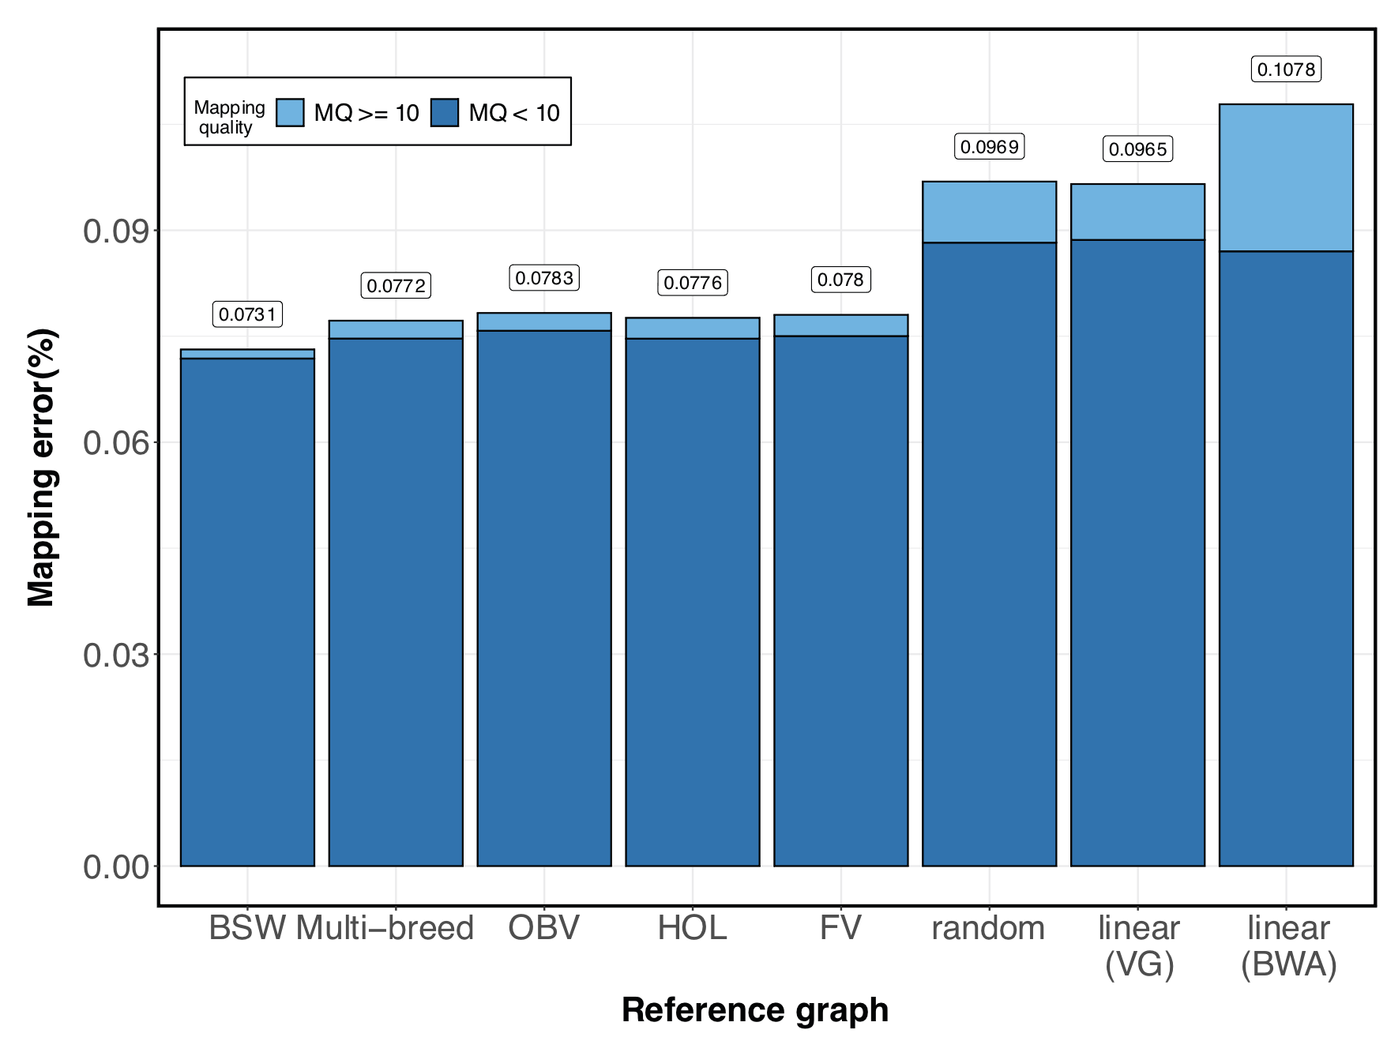
Read mapping to breed-specific versus pangenome graphs
Mapping BSW-simulated reads towards breed-specific, multi-breed, and random graphs
Graph mapping with pre-selected variations is more accurate than linear mapping
The most accurate mapping achieves with breed-specific augmented graphs
Mapping reads to a pangenome graph is almost as accurate
Crysnanto and Pausch, Genome Biology 2020
Introduction Part 1 Part 2 Part 3 Conclusions
Notes:
The second best mapping is achieved with pangenome.
Thus the performance of pangenome is similar as in the population-specific graphs.
Therefore the construction of bovine pangenome is possible that will be applicable across multiple breeds of cattle without compromising mapping accuracy.

Slide 14
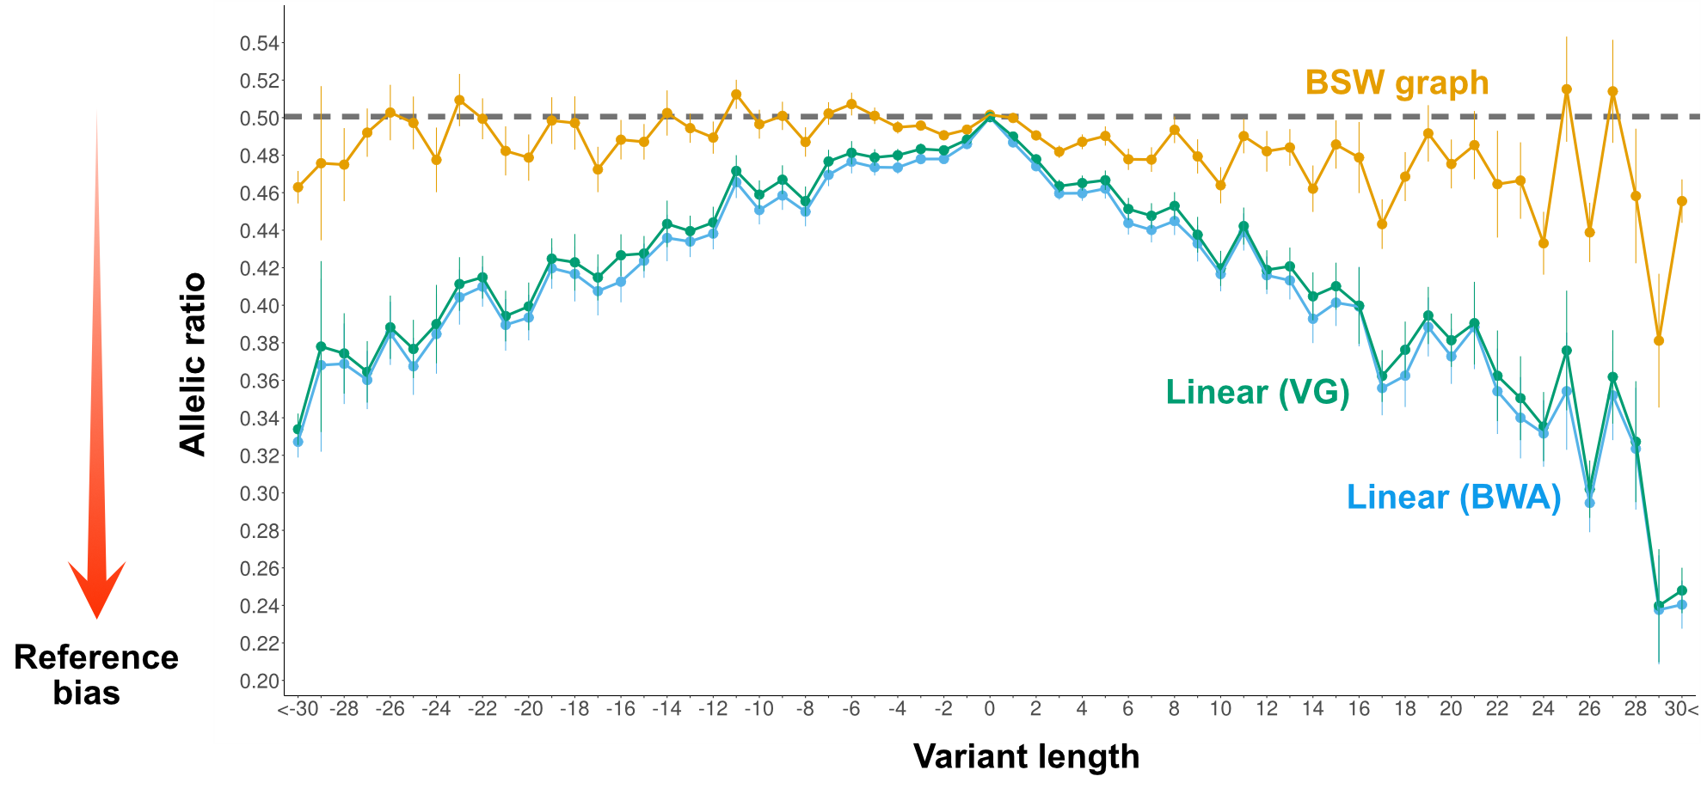
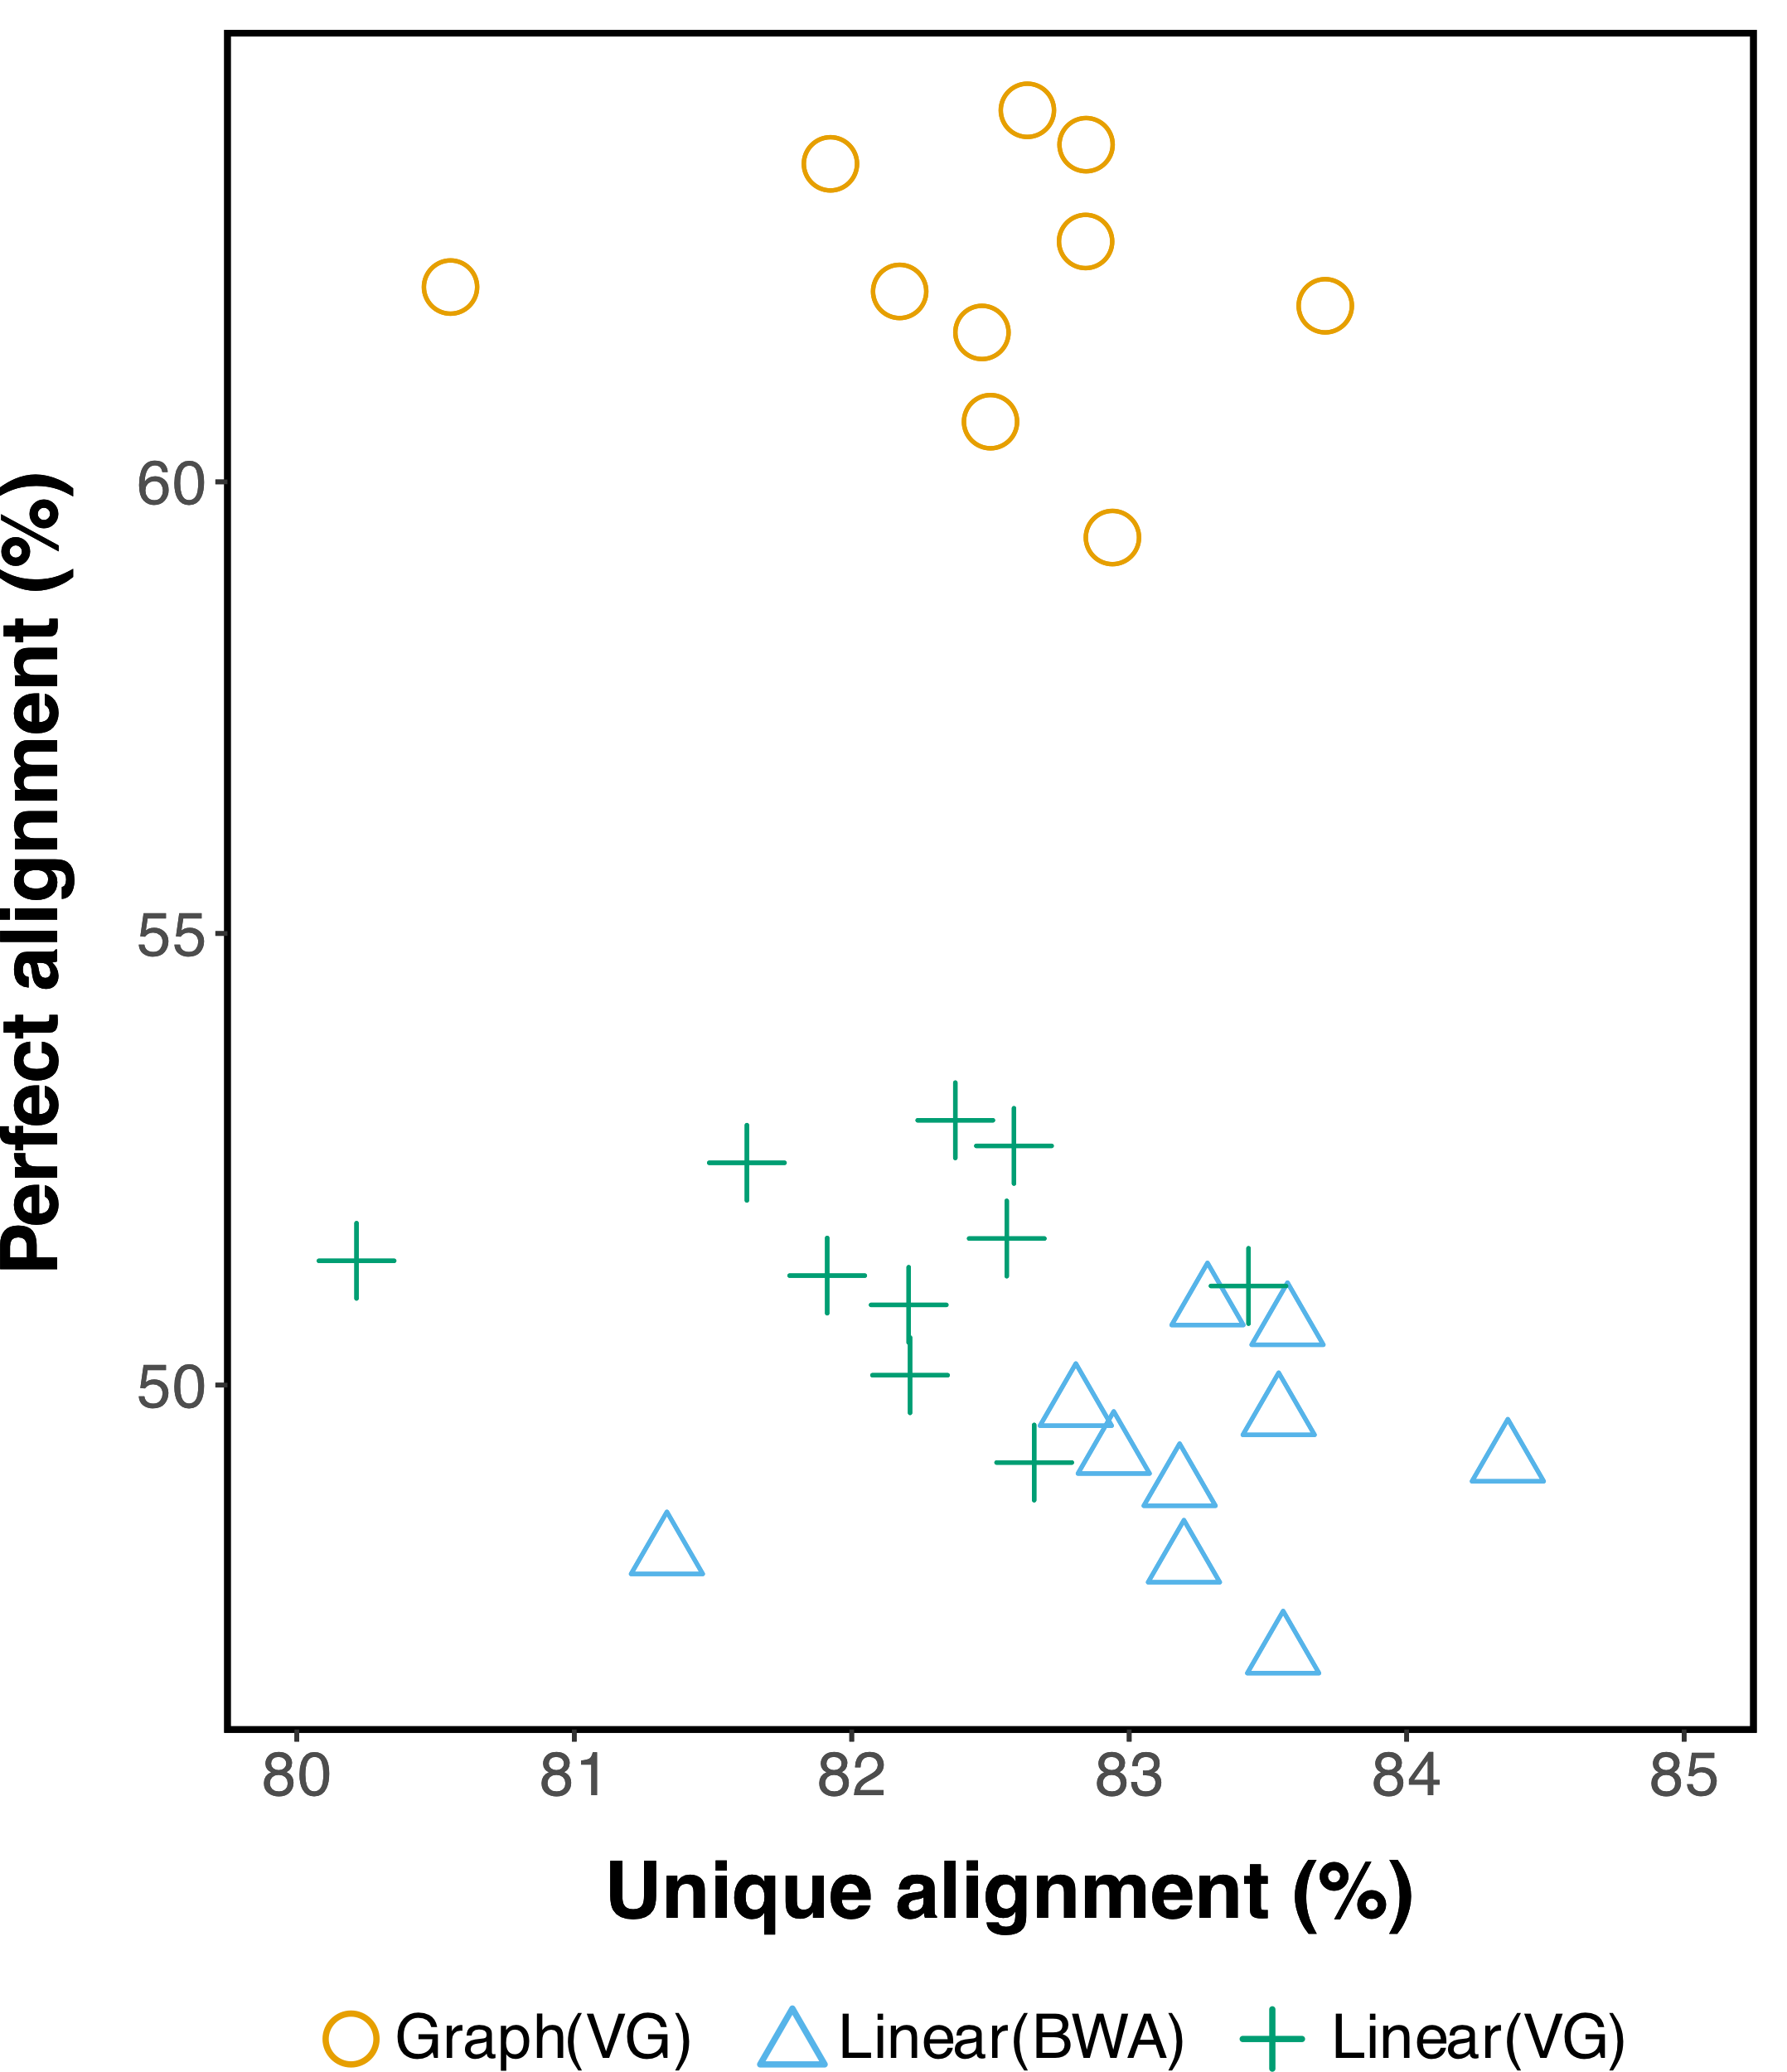
Reduction of reference mapping bias across variant length
Constructed BSW whole-genome graph from 14 million pre-selected variants
Assessed read mapping and genotyping performance on independent BSW samples
Crysnanto and Pausch, Genome Biology 2020
Introduction Part 1 Part 2 Part 3 Conclusions

Slide 15
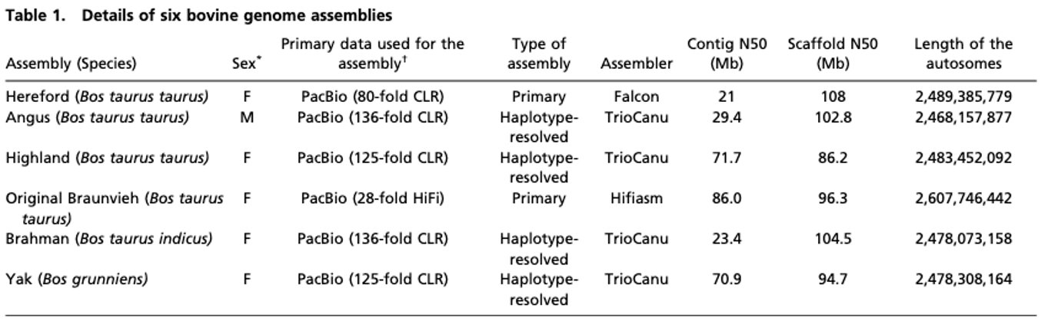
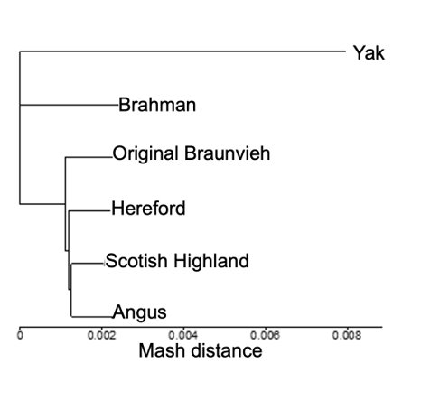
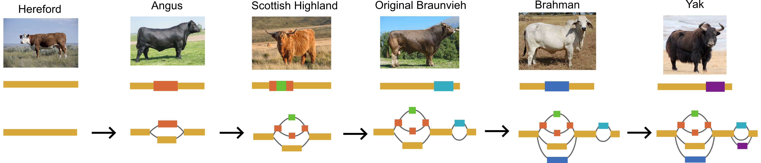
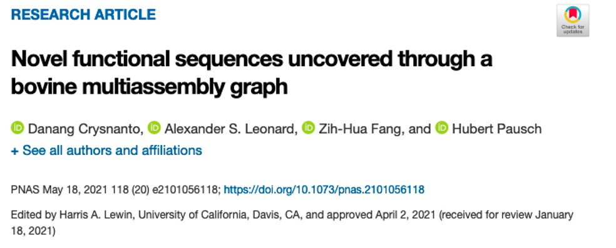
Part 3: Establishing a bovine multi-assembly graph
Integrated 6 cattle assemblies into a pangenome graph using minigraph (Li et. al, 2020)
Backbone
 | Primary data | Assembly type | Contig N50 (Mb) | Scaffold N50 (Mb) | Autosome length (Gb)
Hereford (Bos taurus taurus) | 80-fold CLR Pacbio | Primary | 21 | 108 | 2.489
Angus (Bos taurus taurus) | 136-fold CLR Pacbio | Haplotype resolved | 29.4 | 102.8 | 2.468
Highland (Bos taurus taurus) | 125-fold CLR Pacbio | Haplotype resolved | 71.7 | 86.2 | 2.483
Original Braunvieh (Bos taurus taurus) | 28-fold HiFi Pacbio | Primary | 86 | 96.3 | 2.607
Brahman (Bos taurus indicus) | 136-fold CLR Pacbio | Haplotype resolved | 23.4 | 104.5 | 2.478
Yak (Bos grunniens) | 125-fold CLR Pacbio | Haplotype resolved | 70.9 | 94.7 | 2.478
Rosen et al., 2020
Koren et al., 2018
Rice et al., 2020
Introduction Part 1 Part 2 Part 3 Conclusions

Slide 16
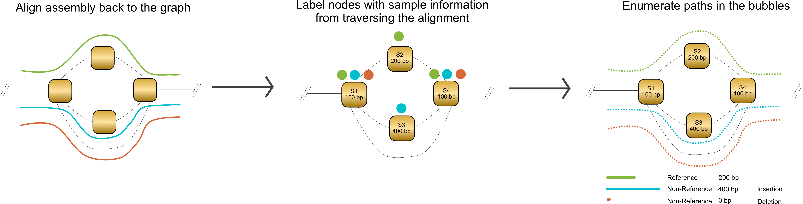
Recovery of non-reference sequences from a multi-assembly graph
Developed a new method to assign sample labels in the graphs→ facilitate extraction of structural variations
Discovered non-reference alleles of SVs with a total length of 70.3 Mb
Explored the sharing of the non-reference sequences across breeds
Crysnanto et al., PNAS 2021
Introduction Part 1 Part 2 Part 3 Conclusions
Notes:
For example, most of the non-reference sequences are derived from Yak which has the largest genetic distance toward to the reference animal.

Slide 17
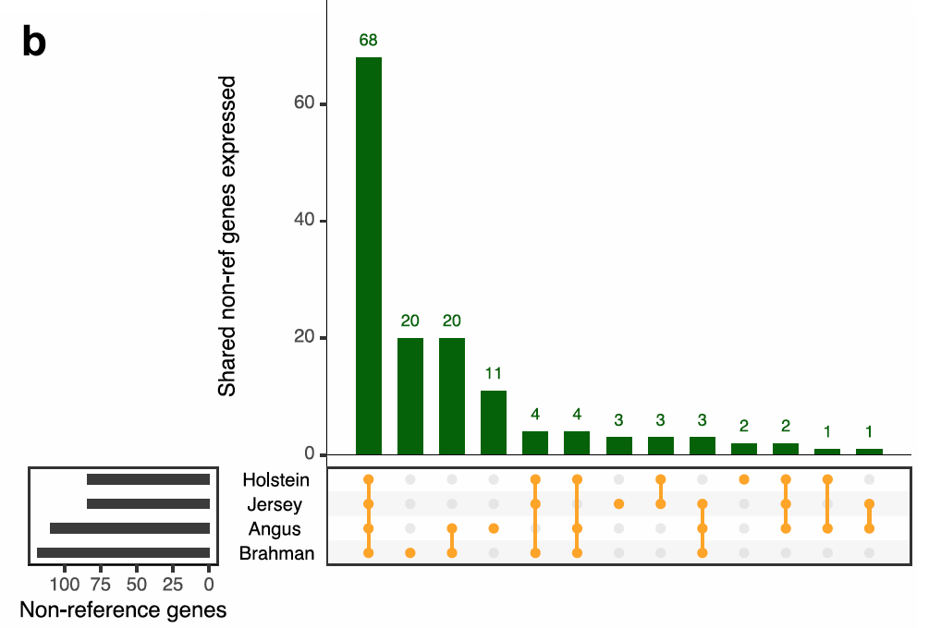
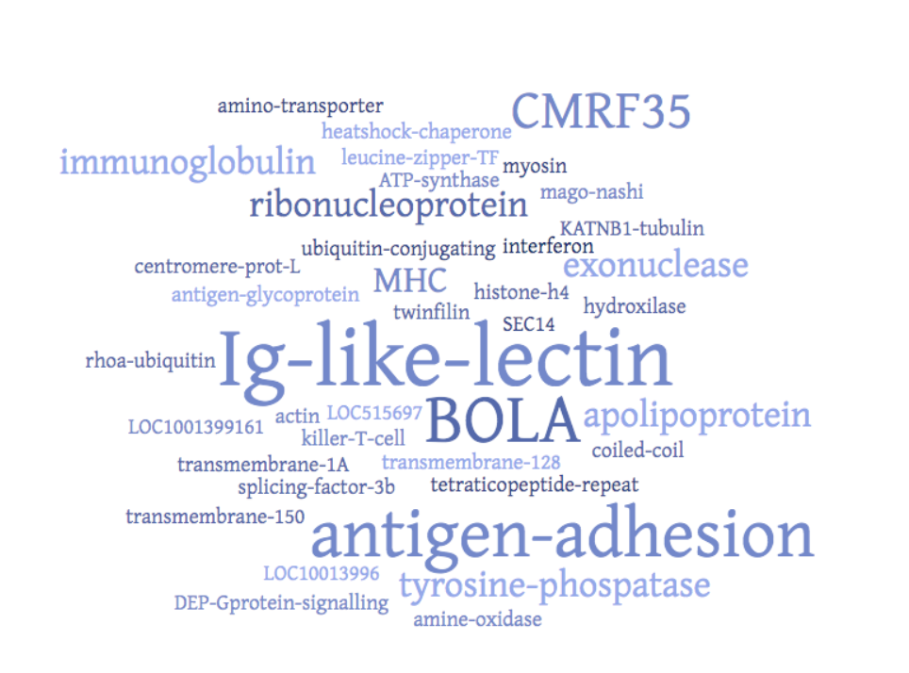
Non-reference sequences contain functionally-active elements
Most of the non-reference sequences are repetitive elements
Validated the expression of putative genes with computational prediction and transcriptome data
The putative genes are related to immune response, signaling, lipid and protein metabolism
Crysnanto et al., PNAS 2021
Introduction Part 1 Part 2 Part 3 Conclusions
Notes:
We furher used the pangenome to ivestigate whetherit contain additionally functionaly active elements

Slide 18
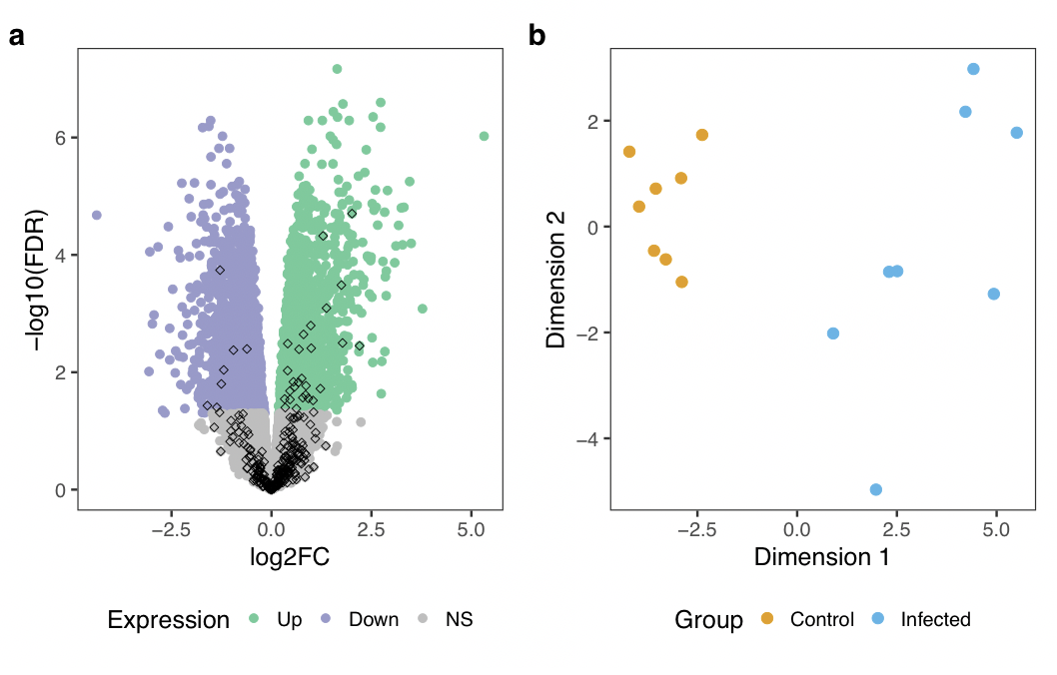
Non-reference sequences contain differentially-expressed transcripts
Revisit analysis on the infection biology of Mycobacterium bovis (McLoughlin et al., 2014)
Transcriptome study of 8 Mycobacterium bovis-infected and 8 non-infected control cattle
Expression of the non-reference genes separate infected from control cattle
36 non-reference genes are differentially expressed
Crysnanto et al., PNAS 2021
Introduction Part 1 Part 2 Part 3 Conclusions

Slide 19
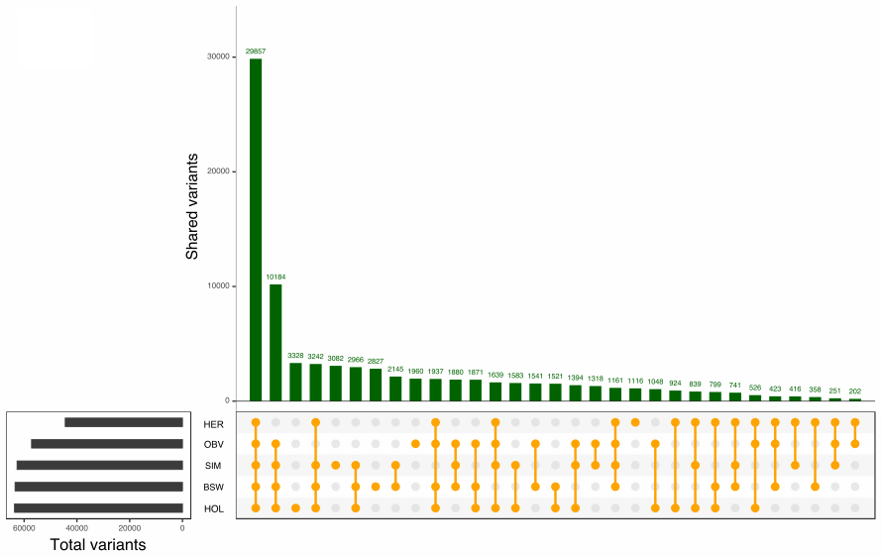
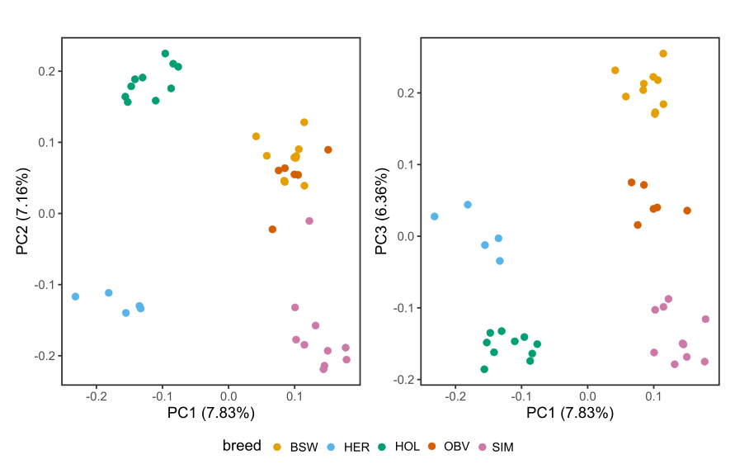
Sequence variants in non-reference sequences are biologically-relevant
Polymorphic non-reference sites that segregate between and within breeds
Variants affecting coding sequences and annotated with high-impacts
Non-reference variants separate the animals by breed
Crysnanto et al., PNAS 2021
Introduction Part 1 Part 2 Part 3 Conclusions

Slide 20
Conclusions
The first application of graph-based approaches in the cattle genome
Graph-based reference is an appealing strategy to mitigate the reference bias
Unbiased and accurate sequence variant discovery
Make so far neglected genetic variations amenable to genomic analysis
Provide a computational framework to exploit a more diverse reference structure
Introduction Part 1 Part 2 Part 3 Conclusions
Notes:
Finally, I will draw up the overal conclusion from my phd

Slide 21
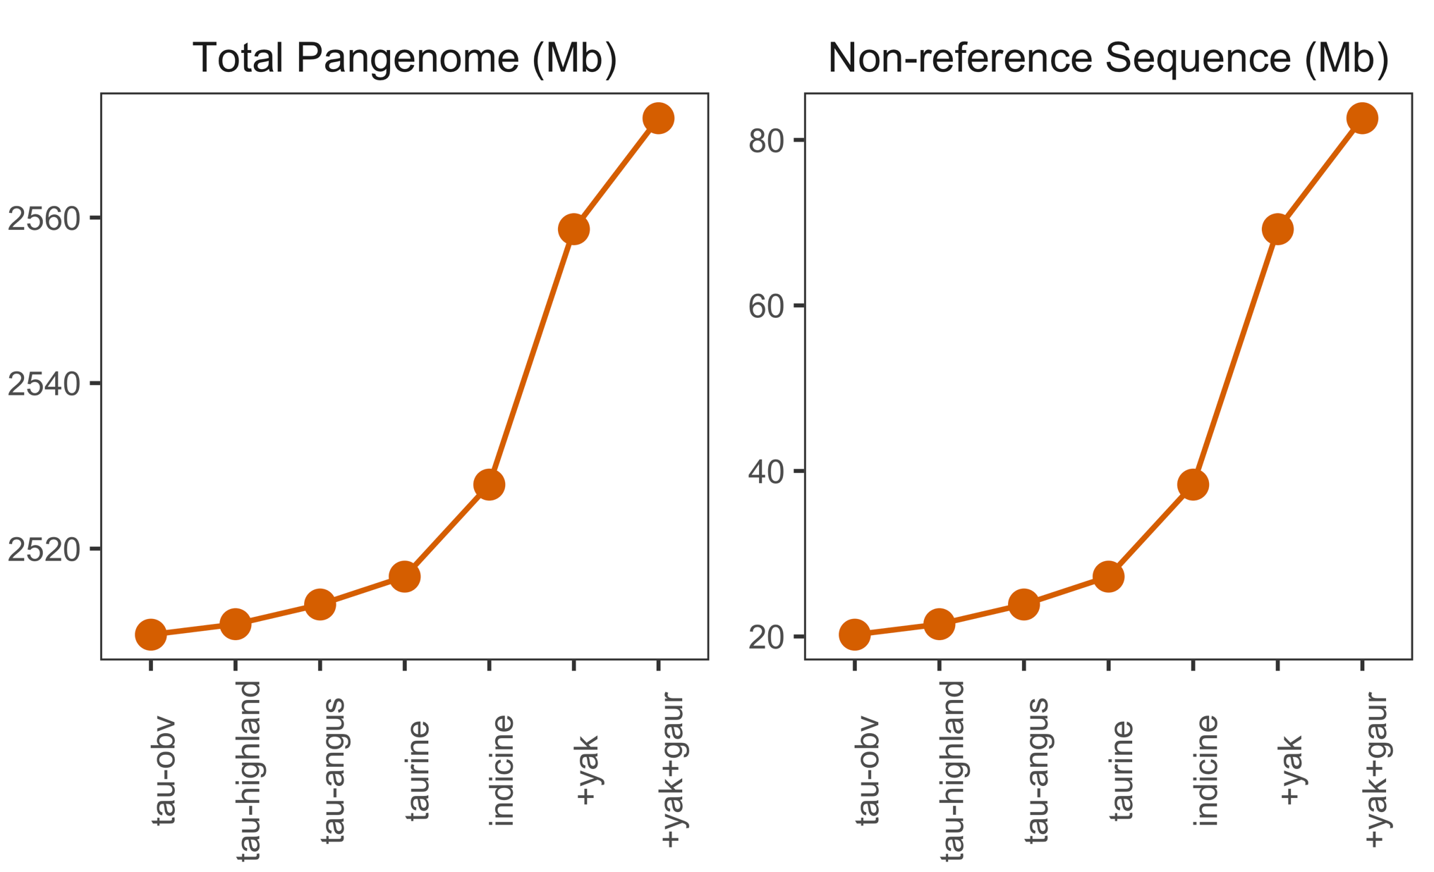
Future Directions
First step towards graph-based pangenome analyses in livestock population
Building comprehensive graphs with more variant classes and breed/species
Integration with functional genomic data
Utilization of graphs for comprehensive genomic analyses
Introduction Part 1 Part 2 Part 3 Conclusions
Notes:
My work can be treated as the first step and starting point for many analysis using graph-based pangenome in livestock genomic
For example, we might start be able to build graph
More affordable

Slide 22





Thank you
Animal Genomics Group
Dr. Alexander S. Leonard
Dr. Naveen Kadri
Dr. Zih-Hua Fang
Dr. Niklas Terhoeven
Maya Hiltpold
Meenu Bhati
Audald Lloret i Villas
Adèla Anoskova
Xena Marie Mapel
Dorota Niedzwiecka
PD Dr. Stefan Neuenschwander
Prof. Hubert Pausch
Functional Genomics
Center Zurich
Many people who made data and software publicly available
Notes:
With this I will finish my presentation, I would like to thank many people who have helped me during in 3.5 years of my phd

Slide 23
References
Sherman, R. M. & Salzberg, S. L. Pan-genomics in the human genome era. Nat. Rev. Genet. (2020). doi:10.1038/s41576-020-0210-7
Rosen, B. D. et al. De novo assembly of the cattle reference genome with single-molecule sequencing. Gigascience 9, (2020).
Crysnanto, D., Leonard, A. S., Fang, Z. H. & Pausch, H. Novel functional sequences uncovered through a bovine multiassembly graph. Proc. Natl. Acad. Sci. U. S. A. 118, 1–29 (2021).
Golicz, A. A., Bayer, P. E., Bhalla, P. L., Batley, J. & Edwards, D. Pangenomics Comes of Age: From Bacteria to Plant and Animal Applications. Trends Genet. 36, 132–145 (2020).
Crysnanto, D. & Pausch, H. Bovine breed-specific augmented reference graphs facilitate accurate sequence read mapping and unbiased variant discovery. Genome Biol. 21, (2020).
Eggertsson, H. P. et al. GraphTyper2 enables population-scale genotyping of structural variation using pangenome graphs. Nat. Commun. 10, 5402 (2019).
Hayes, B. J. & Daetwyler, H. D. 1000 Bull Genomes Project to Map Simple and Complex Genetic Traits in Cattle: Applications and Outcomes. Annu. Rev. Anim. Biosci. 7, annurev-animal-020518-115024 (2019).
Pritt, J., Chen, N.-C. & Langmead, B. FORGe: prioritizing variants for graph genomes. Genome Biol. 19, 220 (2018).
Eggertsson, H. P. et al. Graphtyper enables population-scale genotyping using pangenome graphs. Nat. Genet. 49, 1654–1660 (2017).
Garrison, E. et al. Variation graph toolkit improves read mapping by representing genetic variation in the reference. Nat. Biotechnol. 36, 875–881 (2018).
Li, H., Feng, X. & Chu, C. The design and construction of reference pangenome graphs. Genome Biol. 21, 1–19 (2020).
Bickhart, D. M. et al. Symposium review: Advances in sequencing technology herald a new frontier in cattle genomics and genome-enabled selection. J. Dairy Sci. 103, 5278–5290 (2020).
Paten, B., Novak, A. M., Eizenga, J. M. & Garrison, E. Genome graphs and the evolution of genome inference. Genome Research 27, 665–676 (2017).
Crysnanto, D., Wurmser, C. & Pausch, H. Accurate sequence variant genotyping in cattle using variation-aware genome graphs. Genet. Sel. Evol. 51, (2019).
McLoughlin, K. E. et al. RNA-seq transcriptional profiling of peripheral blood leukocytes from cattle infected with Mycobacterium bovis. Front. Immunol. 5, (2014).

Slide 25
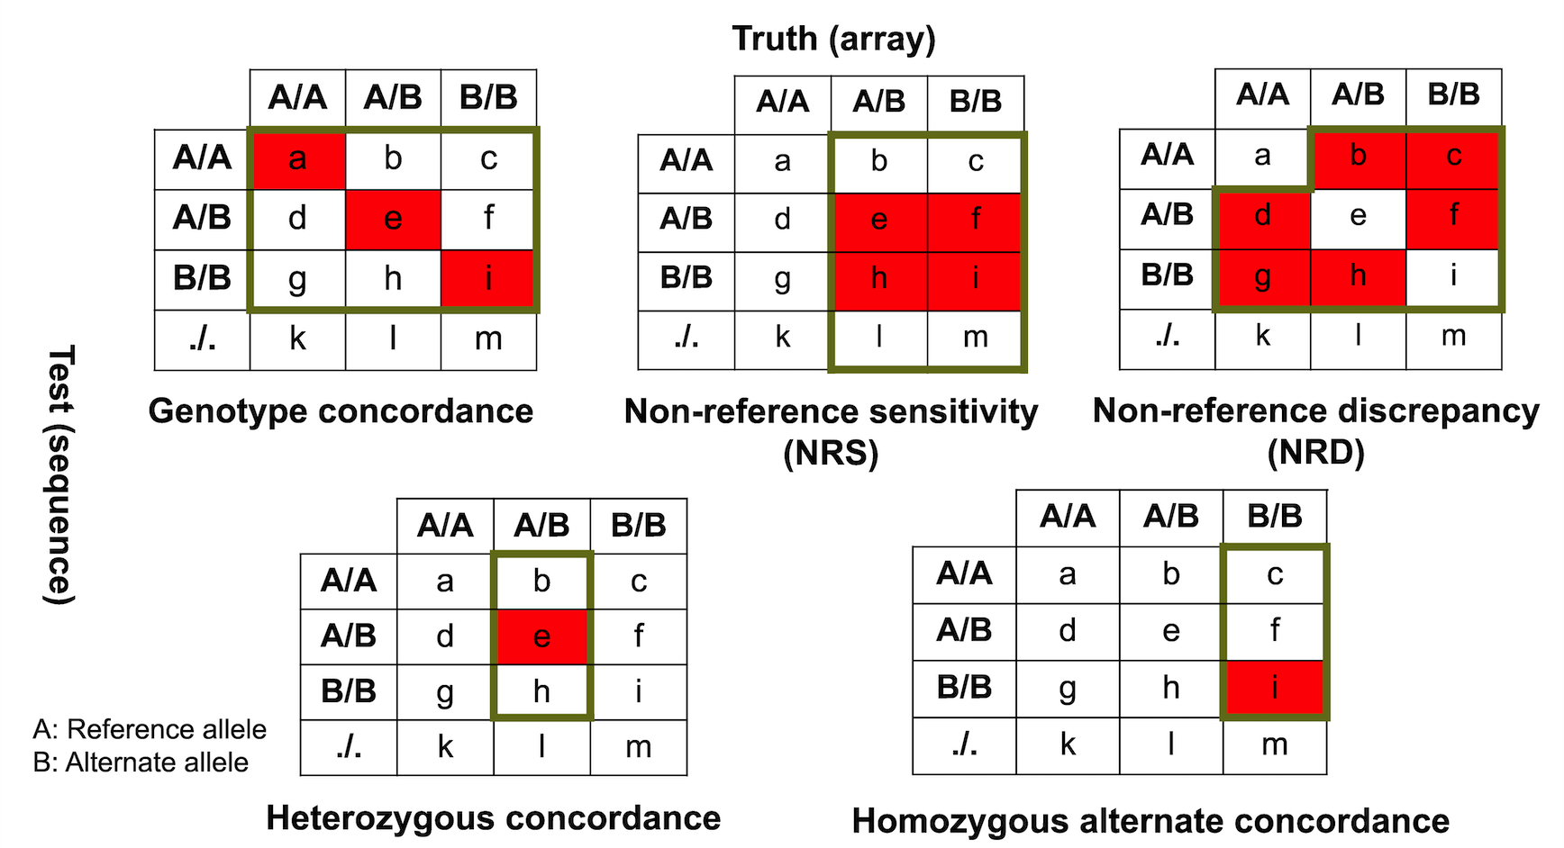
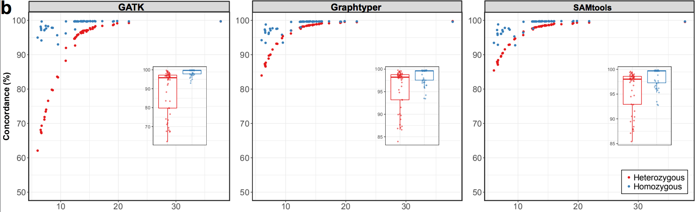
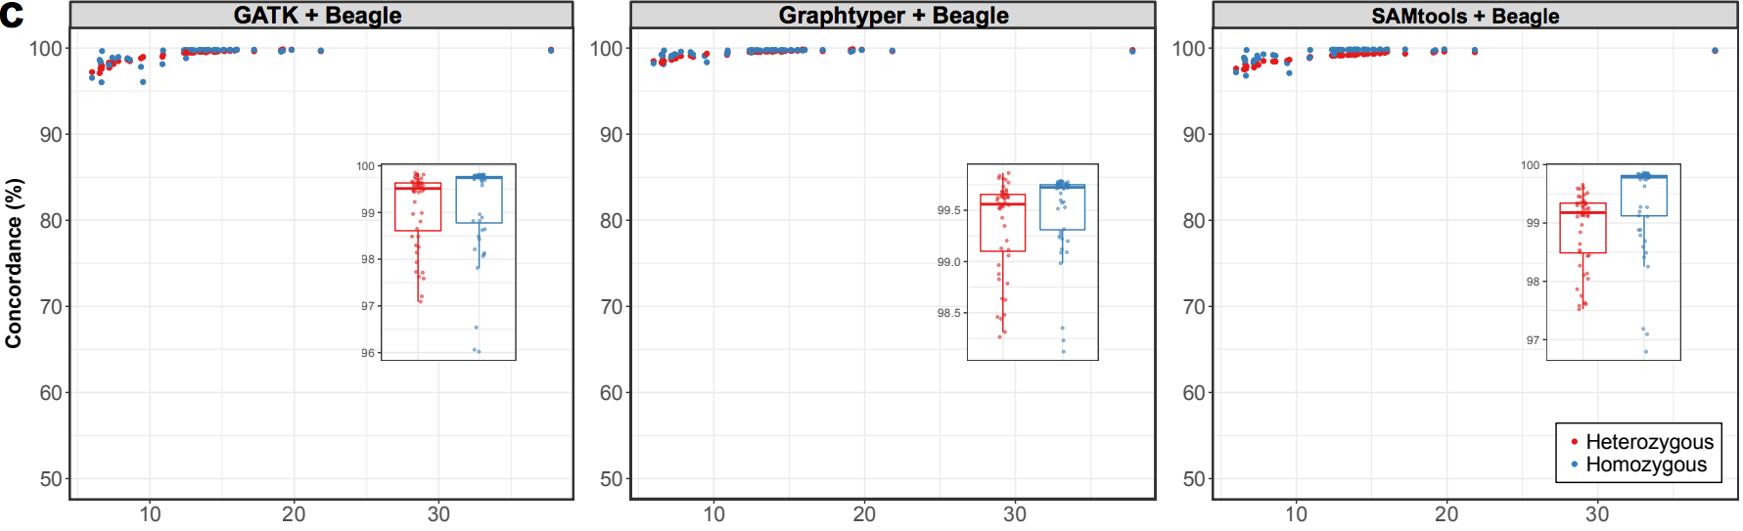

Slide 26
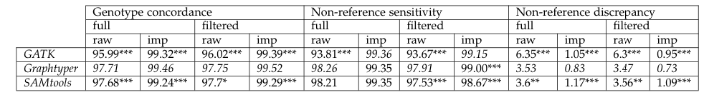
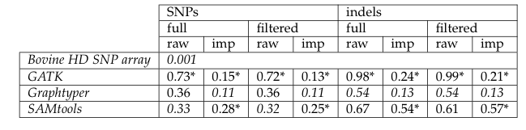

Slide 27
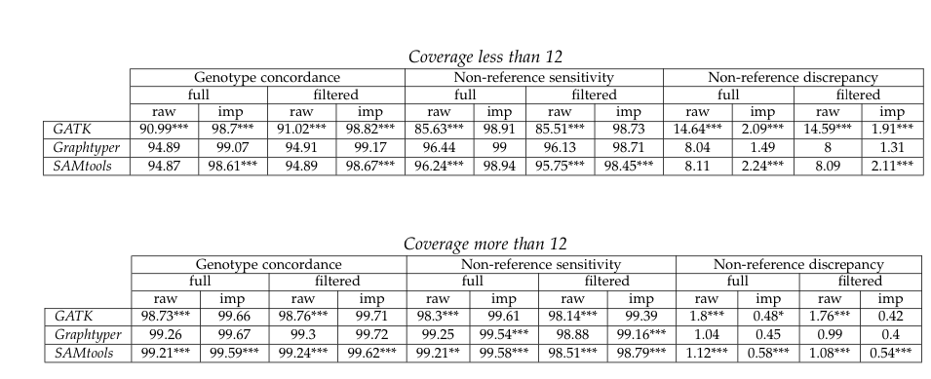
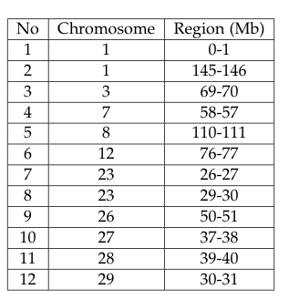
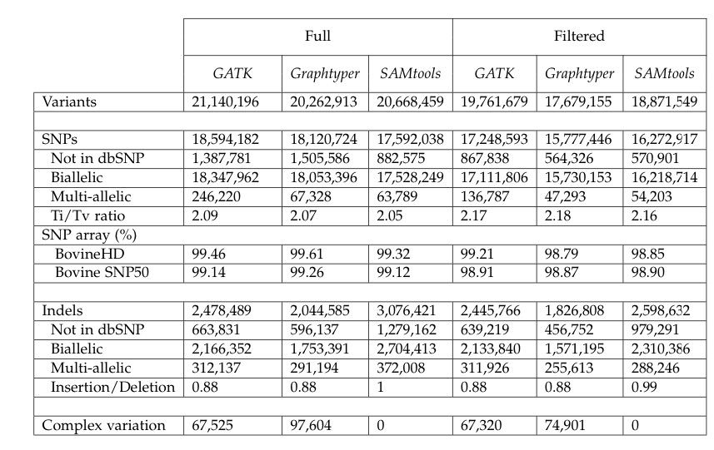
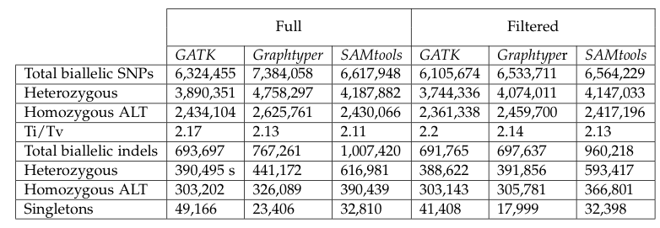

Slide 32
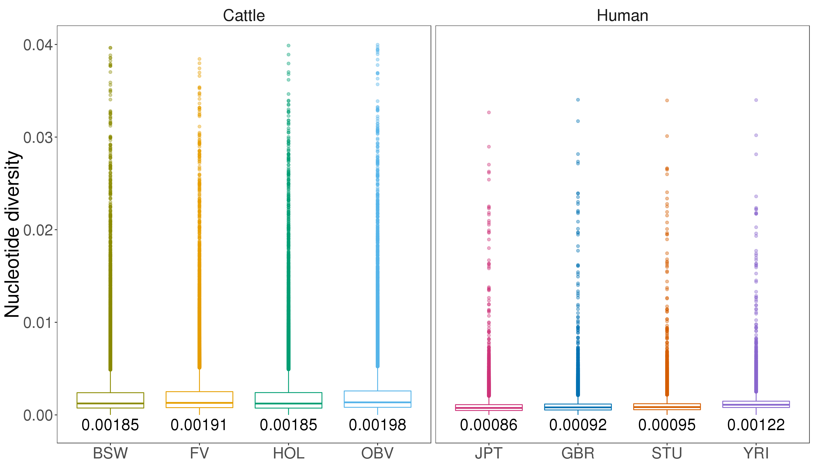

Slide 36
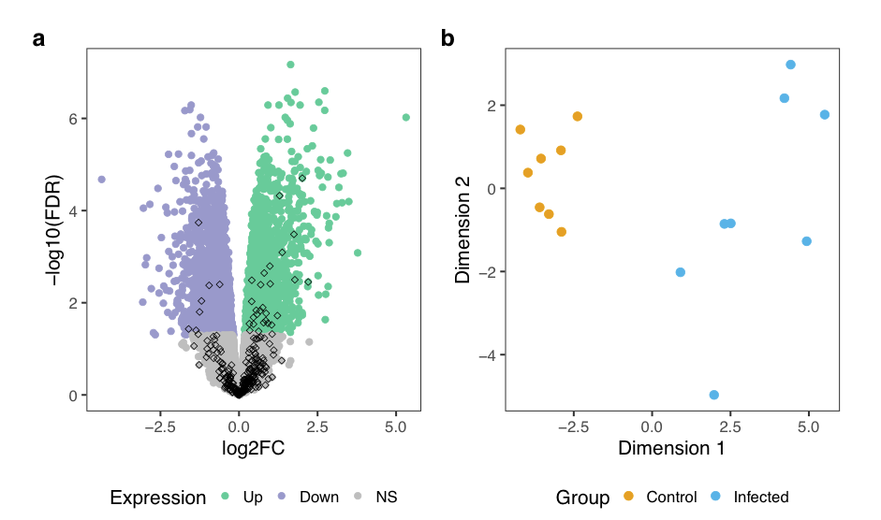

Slide 38
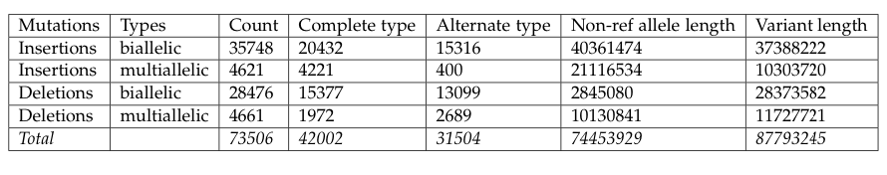

Slide 40
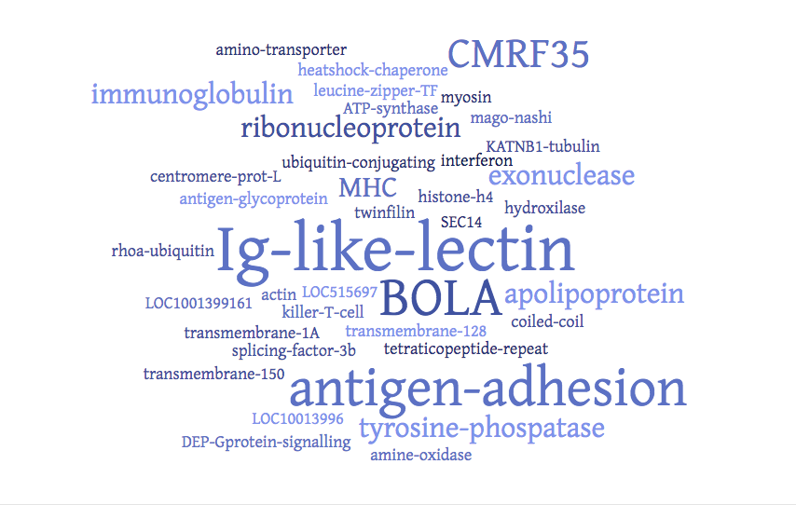
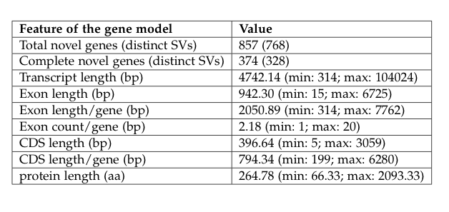
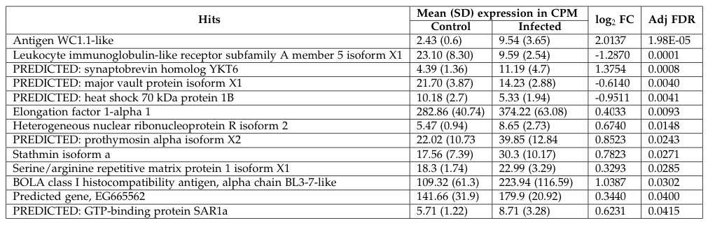

Slide 41
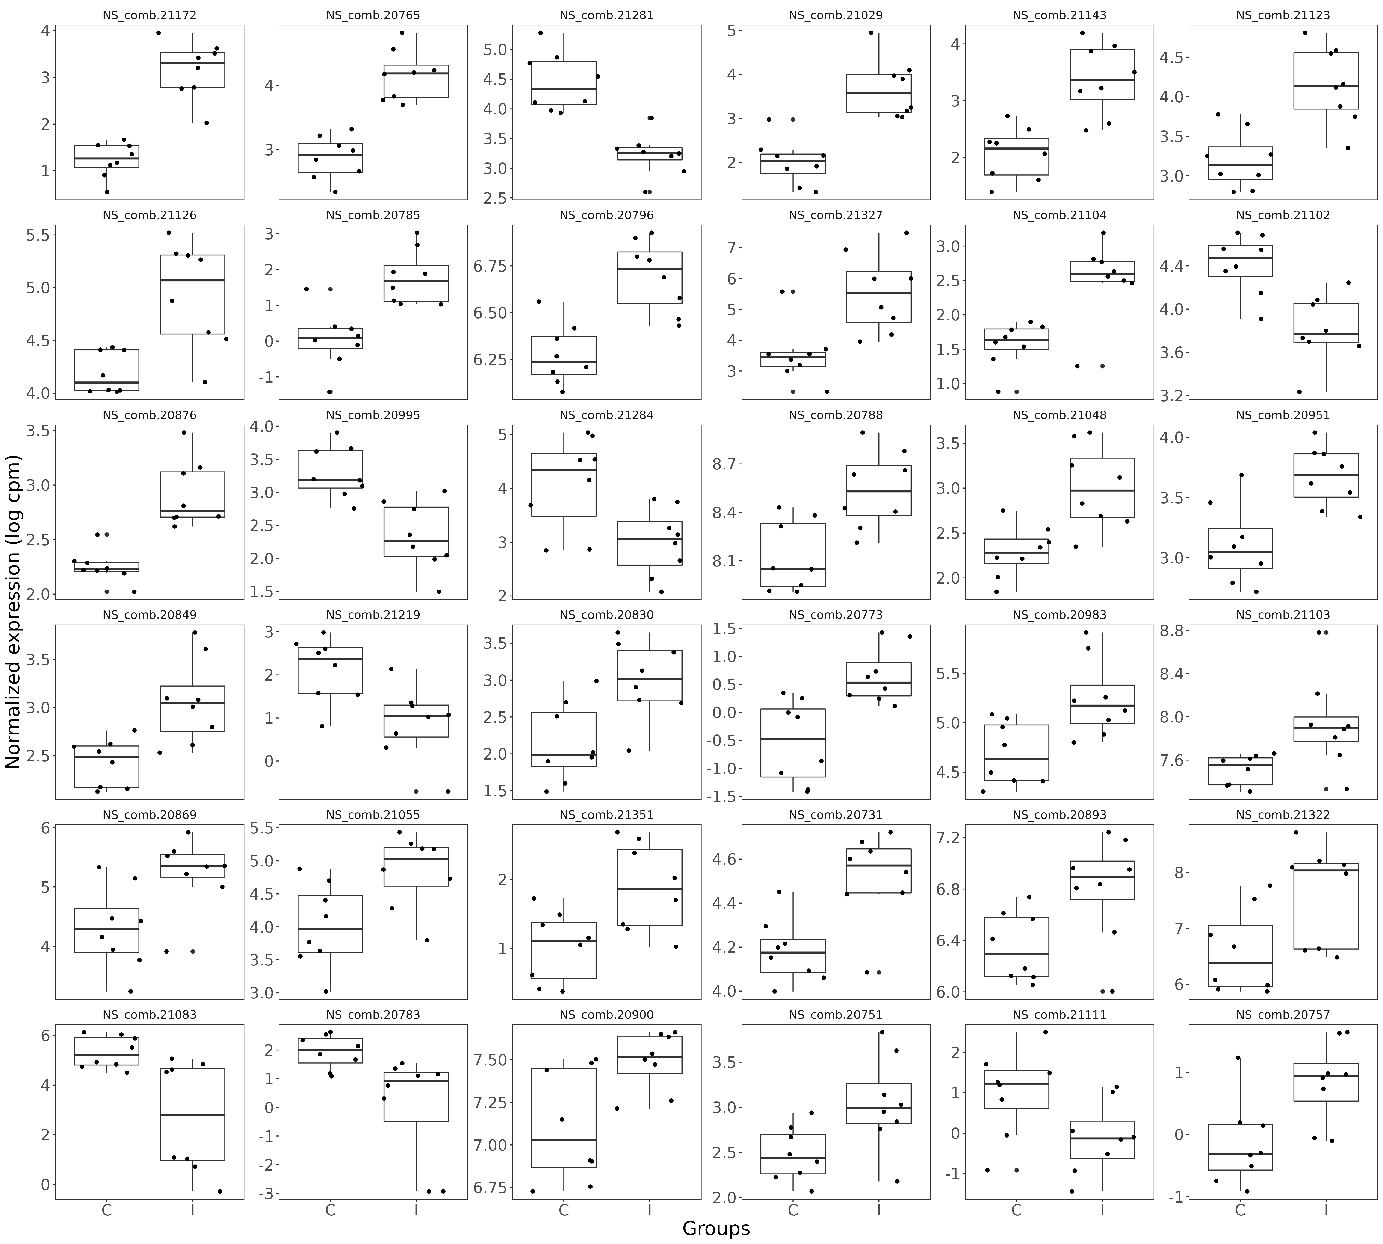
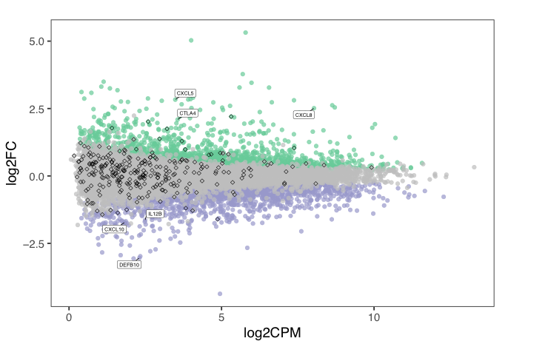
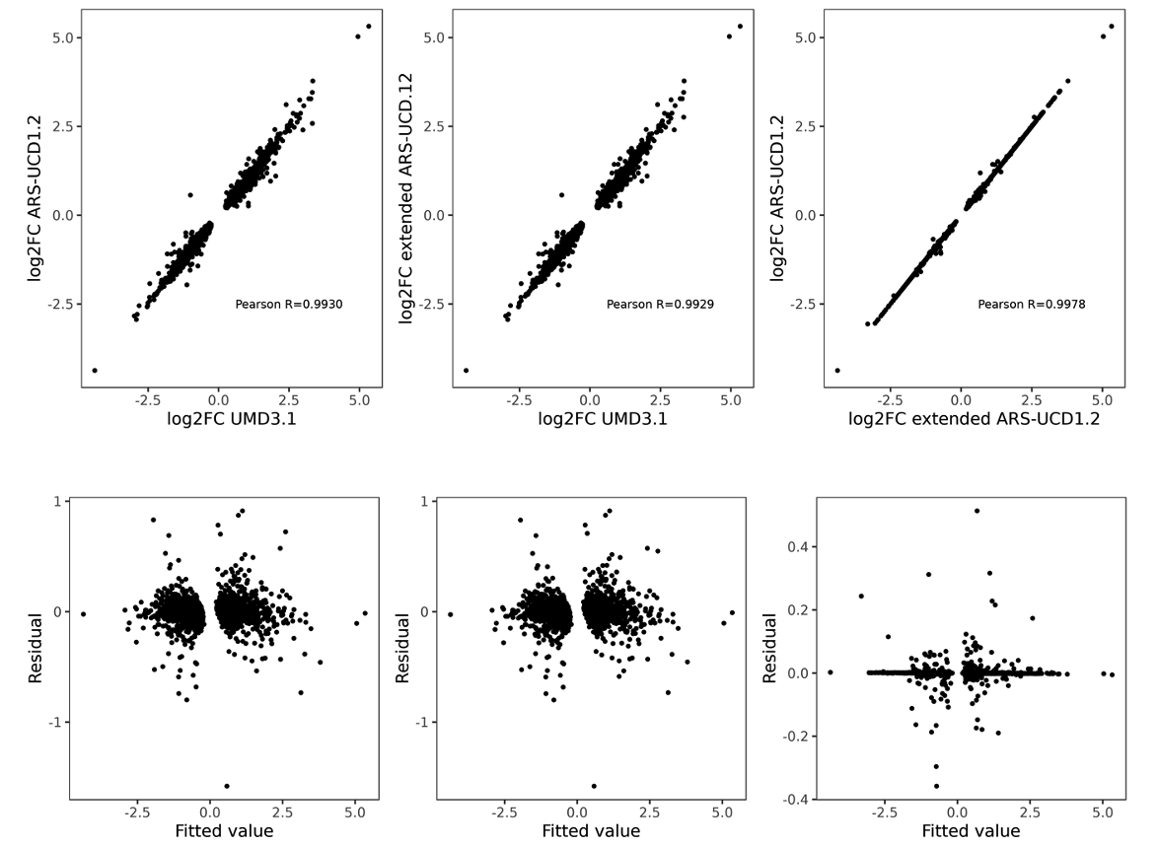
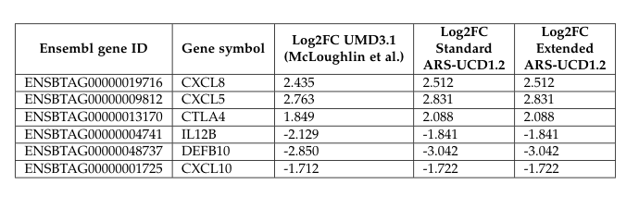

Slide 42
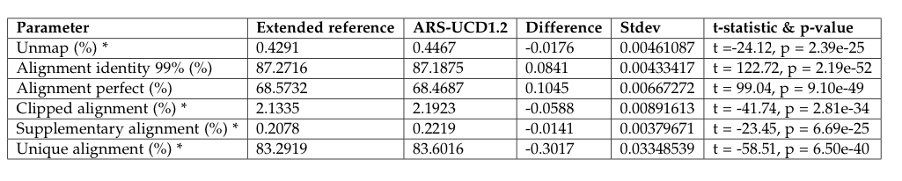
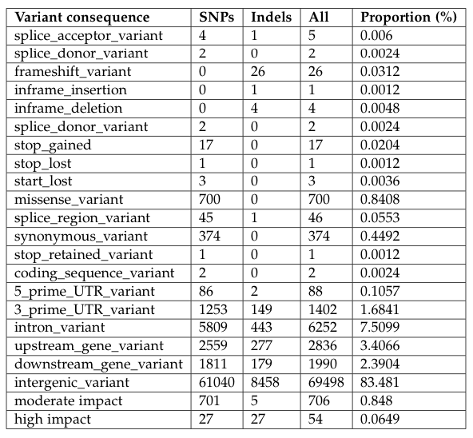

Slide 43
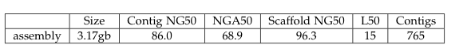
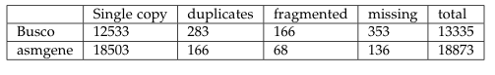
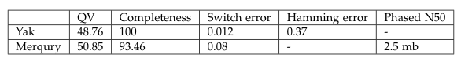

Slide 44
